Slide 1
PRESENTATION ON THE INTERNATIONAL TELECOMMUNICATION UNION’S REPORT:
POWERING THE DIGITAL ECONOMY: REGULATORY APPROACHES TO SECURING CONSUMER PRIVACY, TRUST AND SECURITY
PRIA CHETTY
REGIONAL DIRECTOR, ENDCODE

Slide 2
CONTENT
BACKGROUND TO THE REPORT: THE DIGITAL ECONOMY RELEVANT STAKEHOLDERS IN THE DIGITAL ECONOMY
ONLINE BUSINESS DATA MODELS & DATA MARKETS
MODELS OF ENSURING PROTECTION, PRIVACY & TRUST
DIGITAL IDENTITY
DATA SECURITY
CONCLUSIONS

Slide 3
BACKGROUND TO THE REPORT: THE DIGITAL ECONOMY

Slide 4
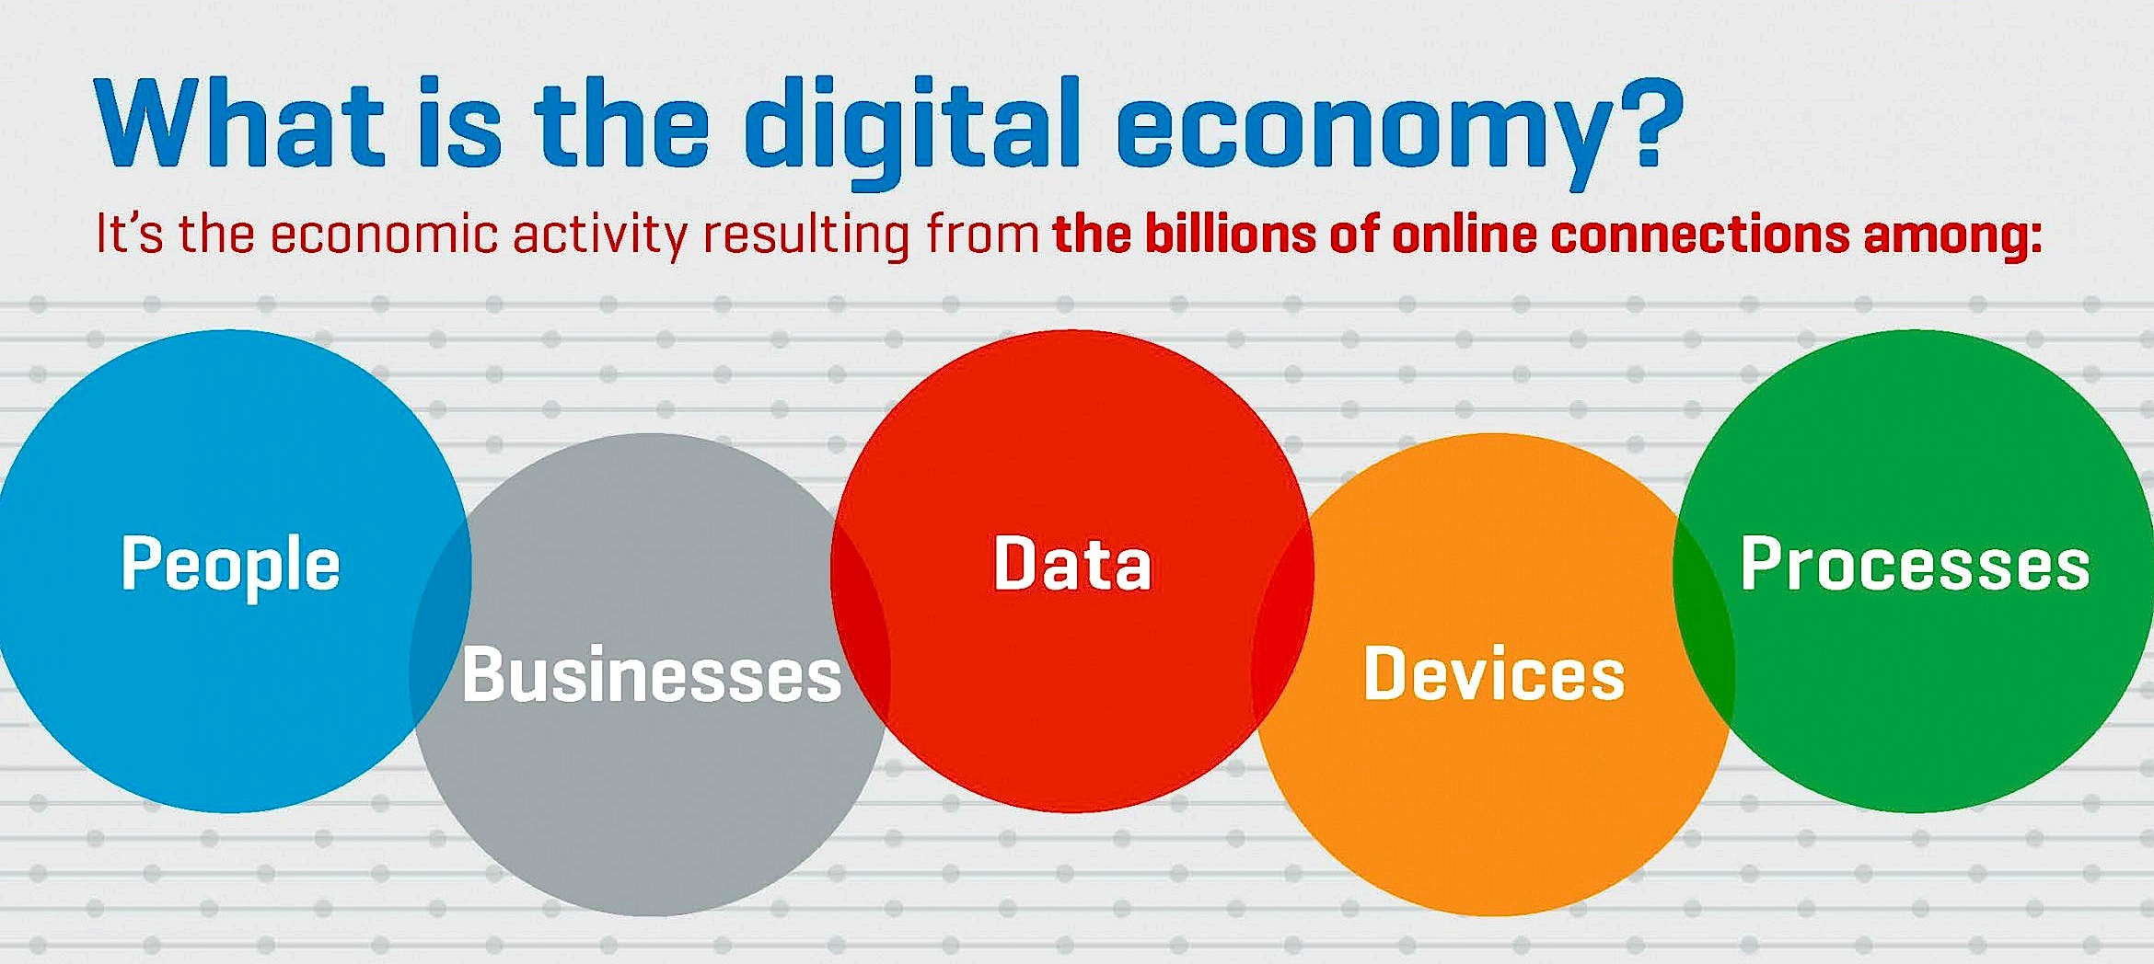
https://nmconnect.org/economic-development/broadband-and-digital-economies

Slide 5
THE DIGITAL ECONOMY
Each year, an increasing number of individuals acquire the means of accessing digital services through lower smartphone prices and greater and better quality network coverage. With this, the potential grows for more conventional services to shift to or to be further enabled in the digital world, as well as for new services to be created that can only exist online.
Laptop + Internet access = create an online business and begin marketing your goods or services to consumers and companies all over the globe. This has dramatically reduced the cost of entry to the business world, especially for small and medium enterprises (SMEs).
Cloud technology has also made it possible for businesses to start up in otherwise difficult data-heavy areas of business, such as banking and insurance.

Slide 6
THE DIGITAL ECONOMY AS A ‘POWER’
International trading platforms, such as Alibaba and Amazon, help drive sales for Asia- and Pacific-based SMEs. Through these platforms, they can reach a global audience, while the platforms themselves offer additional services, such as handling shipping and customer management.
The digital economy has the ability to uplift and connect individuals, businesses, nations and continents.
There is tremendous potential for growth and prosperity in the new digital ecosystem.

Slide 7
None of our documented aspirations - the 2030 Agenda for Sustainable Development, Agenda 2063 – the Africa we want, Africa Continental Free Trade Area, Boosting Intra Africa trade, the Single African Air Transport Market can be achieved without significant advancements in information and communication technology…
Lecture delivered by Dr Omobola Johnson: Digital Transformation of Africa - Hype or Reality?

Slide 8
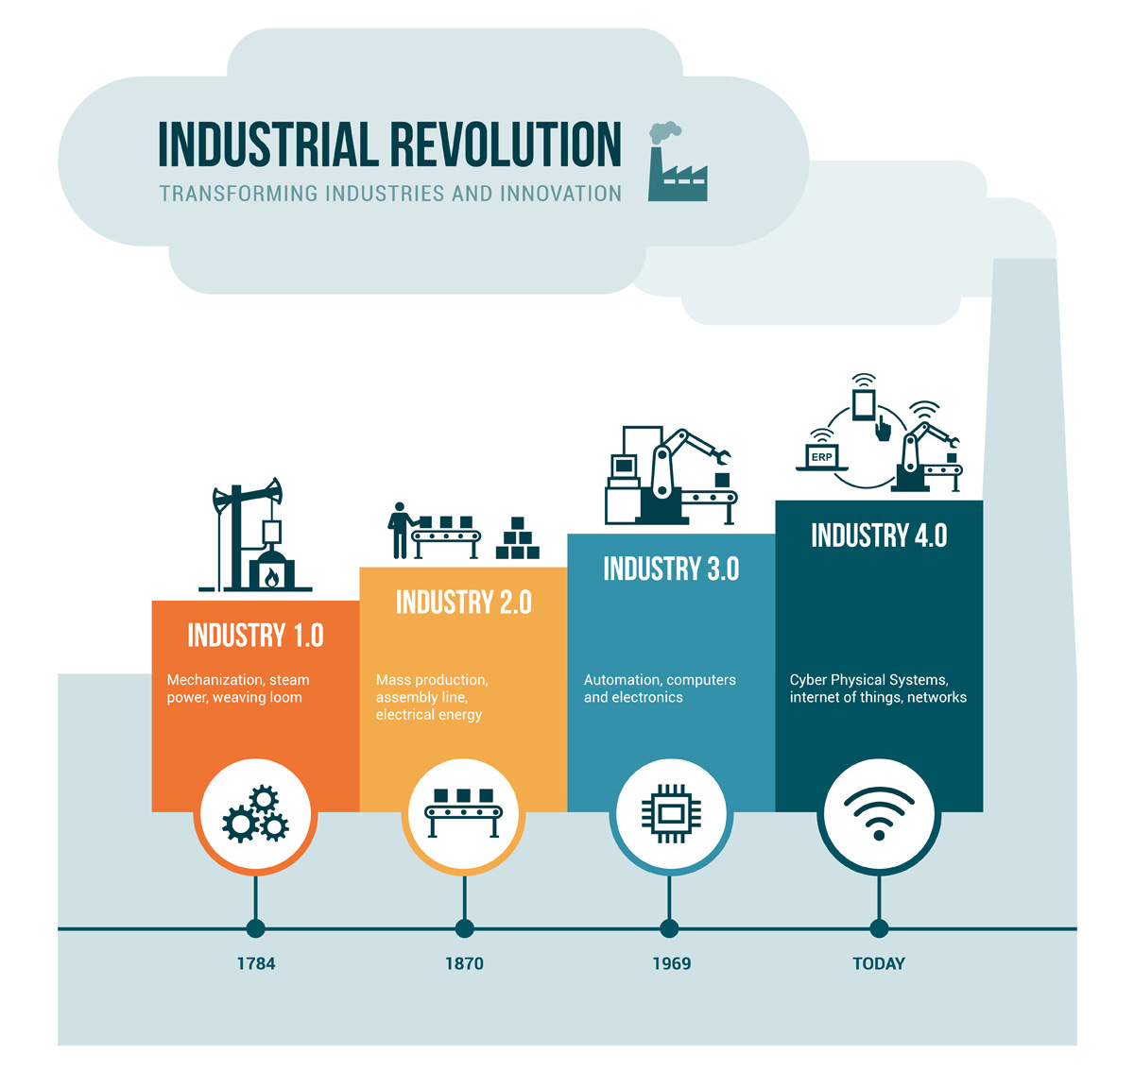
https://www.protocam.com/learningcenter/blog/optimized-3d-production/industrial-revolution2-spacenews-com/

Slide 9
DATA, THE NEW ‘OIL’ DRIVING THE DIGITAL ECONOMY
Without a doubt, data has become one of the most valuable commodities in the world, with continusing increases in digitalisation. Companies such as Amazon, Apple, Facebook and Google dominate the top of the list of the world’s most valuable companies, leading some to proclaim that data is the new oil.
Data is the new currency for businesses.
Transactions and communications are dependent on attribution and identity.
Data, especially personal-data or collections of anonymised data, power the Digital Economy.

Slide 10
TRUST AND DIGITAL ECONOMY
The Digital Economy is a powerful medium for consumers but ensuring trust and privacy is key.
Targeted advertising means that people all over the world receive advertisements based on their online activity and personal interests, making it more likely for them to buy consumer goods and services.
Data is increasingly used to profile users based on, among other things, their online search history, active social media commentary, tagged geo-locations, online purchases, as well as political preferences, sexual orientation, and much more.
Data privacy concerns that arise out of AI systems (including those based on social media profile data analysis) have significant similarities to the data privacy concerns already present with telecommunication user data (including mobile location data).

Slide 11
THE DIGITAL ECONOMY: BALANCING INTERESTS
Free flow of data is a significant driver of the digital economy, a force of economic growth and globalisation – global data flows contributing more year on year to global GDP.
Balancing interests in ensuring adequate free flow of data, consumer interests including trust and privacy in a digital economy and developing readiness for emerging technology is a complex ask. The ITU Report looks at:
  Mapping out the relevant stakeholders involved in creating, processing and regulating personal data (consumers; private sector; regulators; and government);
  Understanding online data business models and data markets;
  Models of ensuring protection, privacy and trust;
  Digital Identity; and
  Data Security.

Slide 12
RELEVANT STAKEHOLDERS IN THE DIGITAL ECONOMY

Slide 14
DATA PROTECTION AUTHORITIES
A growing number of countries have introduced or are introducing Data Protection Authorities (DPAs).
DPAs administer data protection legislation and regulate through various regulatory models data protection (and privacy) in the country of jurisdiction.
DPAs can issue guidance on compliance with data protection regulation and administer fines as well as impose other sanctions.
DPAs can take a Commission structure tasked with the formal regulatory functions of the Authority with an operational arm that establishes an organisation around the Commission.
Australian legislators have taken a different approach to privacy regulating the use of personal information on the premise of anti-trust and competition.
The ACCC considers for instance digital platforms in country not only for market competition impact but also for significance on privacy in country.
Australia is introducing a Consumer Data Right.

Slide 15
COLLABORATION BETWEEN ICT & DATA PROTECTION REGULATORS

Slide 16
ONLINE BUSINESS DATA MODELS & DATA MARKETS

Slide 17
THE TWO-SIDED APP BASED ECONOMY
Unlike traditional seller-buyer based markets, the two-sided market, looking particularly at the use of apps, is revolutionising not only the way that we carry out transactions, but also what products and services we now have access to, and, crucially, the pricing (as a result of reduced infrastructure and costs involved).

Slide 18
DATA OWNERSHIP & MONETIZATION
Data, like any commodity in a competitive market place, has value.
Organisations that rapidly acquire and manage relevant data have a valuable commodity to monetise over time.
Governments working to adapt and update their data protection laws and regulations to keep up with the rapid changes occurring in the fast-paced data market.
Data subjects retain ownership of their personal data under data protection laws, data controllers and processors can use and monetise this personal data, as long as a set of principles are adhered to.

Slide 19
MODELS OF ENSURING PROTECTION, PRIVACY & TRUST

Slide 20
DATA PROTECTION & PRIVACY ACROSS REGIONS
A growing global dataflow and the expanding use of personal data in the global economy have led to an increase in the adoption and development of national and regional privacy laws and regulations.
At least 109 countries around the world have adopted some form of data protection and privacy legislation. 10% of countries have draft legislation. 21% have no legislation.

Slide 21
PROMINENT: PROTECTION OF PRIVACY & TRUST
A significant global initiative is Council of Europe Convention 108 on data protection, which currently has six non-Council of Europe member countries as parties to the convention (Cape Verde, Mauritius, Mexico, Senegal, Tunisia and Uruguay). Convention 108 was updated in May 2018, in order to modernize the Convention in the wake of GDPR.
The Asia-Pacific Economic Cooperation (APEC) has adopted the APEC Privacy Framework based on the OECD guidelines.
The Association of South-East Asian Nations (ASEAN) similarly adopted a regional Framework on Personal Data Protection which is compatible with the APEC framework.

Slide 22
PROMINENT INSTRUMENTS: PROTECTION OF PRIVACY & TRUST
The African Union Cybersecurity Convention and Personal Data Protection (AUCC) was adopted at the 23rd Ordinary Session of the Assembly of the Union, Malabo, on the 27th June 2014.
Establishes a Legal Framework for Cyber-security and Personal Data Protection that embodies the existing commitments of African Union Member States at sub- regional, regional and international levels to build the Information Society and address the need for harmonized legislation in the area of cyber security in Member States of the African Union.
15 Ratifications required for entry into force
Signatures (11): Benin, Chad, Comoros, Congo, Ghana, Guinea Bissau, Mauritania, Mozambique, Sierra Leone, Sao Tome and Principe, and Zambia
Accessions & Deposits (4): Guinea, Mauritius, Namibia, Senegal
https://au.int/sites/default/files/treaties/29560-sl-african_union_convention_on_cyber_security_and_personal_data_protection_2.pdf

Slide 23
ARTICLE 8: OBJECTIVE OF THIS CONVENTION WITH RESPECT TO PERSONAL DATA
1. Each State Party shall commit itself to establishing a legal framework aimed at strengthening fundamental rights and public freedoms, particularly the protection of physical data, and punish any violation of privacy without prejudice to the principle of free flow of personal data.
2. The mechanism so established shall ensure that any form of data processing respects the fundamental freedoms and rights of natural persons while recognizing the prerogatives of the State, the rights of local communities and the purposes for which the businesses were established.

Slide 24
ARTICLE 11: STATUS, COMPOSITION AND ORGANIZATION OF NATIONAL PERSONAL DATA PROTECTION AUTHORITIES
Each State Party shall establish an authority in charge of protecting personal data.
The national protection authority shall be an independent administrative authority with the task of ensuring that the processing of personal data is conducted in accordance with the provisions of this Convention.
Each national protection authority shall formulate rules of procedure containing, inter alia, rules governing deliberations, processing and presentation of cases.
State Parties shall undertake to provide the national protection authority with the human, technical and financial resources necessary to accomplish their mission.

Slide 25
ARTICLE 24: NATIONAL CYBER SECURITY FRAMEWORK
1. National policy
Each State Party shall undertake to develop, in collaboration with stakeholders, a national cyber security policy which recognizes the importance of Critical Information Infrastructure (CII) for the nation identifies the risks facing the nation in using the all hazards approach and outlines how the objectives of such policy are to be achieved.
2. National strategy
State Parties shall adopt the strategies they deem appropriate and adequate to implement the national cyber security policy, particularly in the area of legislative reform and development, sensitization and capacity-building, public-private partnership, and international cooperation, among other things. Such strategies shall define organizational structures, set objectives and timeframes for successful implementation of the cyber security policy and lay the foundation for effective management of cyber security incidents and international cooperation.

Slide 26
ARTICLE 25: LEGAL MEASURES
1. Legislation against cybercrime: Each State Party shall adopt such legislative and/or regulatory measures as it deems effective by considering as substantive criminal offences acts which affect the confidentiality, integrity, availability and survival of information and communication technology systems, the data they process and the underlying network infrastructure, as well as effective procedural measures to pursue and prosecute offenders. State Parties shall take into consideration the choice of language that is used in international best practices.
2. National Regulatory Authorities: Each State Party shall adopt such legislative and/or regulatory measures as it deems necessary to confer specific responsibility on institutions, either newly established or pre-existing, as well as on the designated officials of the said institutions, with a view to conferring on them a statutory authority and legal capacity to act in all aspects of cyber security application, including but not limited to response to cyber security incidents, and coordination and cooperation in the field of restorative justice, forensic investigations, prosecution, etc.
3. Rights of citizens: In adopting legal measures each State Party shall ensure that the measures so adopted will not infringe on the rights of citizens guaranteed under the national constitution and internal laws, and protected by international conventions, particularly the African Charter on Human and Peoples‟ Rights, and other basic rights such as freedom of expression, the right to privacy and the right to a fair hearing, among others.
4. Protection of critical infrastructure: Each State Party shall adopt such legislative and/or regulatory measures as they deem necessary to identify the sectors regarded as sensitive for their national security and well-being of the economy, as well as the information and communication technologies systems designed to function
in these sectors.

Slide 27
PROMINENT LEGAL INSTRUMENTS TO ENSURE PROTECTION OF PRIVACY & TRUST
The GDPR: on 25 May 2018, EU GDPR came into force in all 28 EU member states. While the new regulation and the old EU directive share much of their content and principles, GDPR is much stricter, placing fines on companies of up to 4% of global revenue or EUR 20 million (which- ever is highest), and increasing the legal requirements and accountability for data controllers and data processors
Sector-specific Laws: for example, America approaches protecting privacy & trust through sector-specific laws as opposed to an omnibus data protection law or regulation.
Regulatory Guidelines: Guidelines are not in and of themselves legally binding either for data controllers or the DPAs themselves, who can change their guidelines as needed. Guidelines do however give a good indication of what DPAs consider to be good practice, and what they will focus on in case of violations.

Slide 28
DATA PROTECTION & PRIVACY ACROSS REGIONS
While countries adopt different types of legislation, data protection regimes are predominantly based on a set of core principles which stem from the OECD Guidelines on the Protection of Privacy and Transborder Flows of Personal Data. These core principles are:

Slide 29
DATA PROTECTION & PRIVACY REGULATION
UNCTAD 2016 Report: warned that divergence in data protection regulation at regional and national levels has the potential to hinder the growth of digital markets. When considered in light of necessary cross-border transfers of data, this potential to hinder growth of digital markets becomes apparent.
  Overregulation has the potential to hinder global growth, and called for a fair balance between international trade and privacy considerations.

Slide 30
MODELS FOR REGULATION
Three different types of regulation are identified by Professor Dennis D. Hirsch: direct regulation, self-regulation, and co-regulation (which can be similar to collaborative regulation between the private sector and the regulator).
Each of these models of regulation can be applied at three different levels: company; sector wide (a specific type of sector, or the private sector only); or to the economy as a whole (including both the private and public sectors).
Sector-specific regulatory approaches have the advantage of being tailored to specific sectors, but they can, at the same time, make it difficult for citizens and consumers to understand and to get an overview of whether their rights are within this regime.

Slide 31
MODELS FOR REGULATION
The strength of self-regulation is that it can be flexible and able to keep up with industry changes, advances in technology, and new business practices.
Co-regulation occurs when government agencies and private businesses work together to create privacy regulations, either covering individual businesses, or a specific sector. Under co-regulation, governments and industry share the responsibility for drafting, monitoring and enforcing privacy standards:
  GDPR is a good illustration of this. While GDPR does apply to the economy as a whole, it also contains general principles which companies need to assess in order to become compliant.
  Binding Corporate Rules (BCR) are examples of co-regulation applied at a single company, corporation, or business venture.

Slide 32
DIGITAL IDENTITY

Slide 33
DEFINING DIGITAL IDENTITY
A digital identity may be defined as ‘a collection of electronically captured and stored identity attributes that uniquely describe a person within a given context and are used for electronic transactions.
The ITU, in Recommendation ITU-T X.1252, defines digital identity as ‘a digital representation of the information known about a specific individual, group or organization’

Slide 34
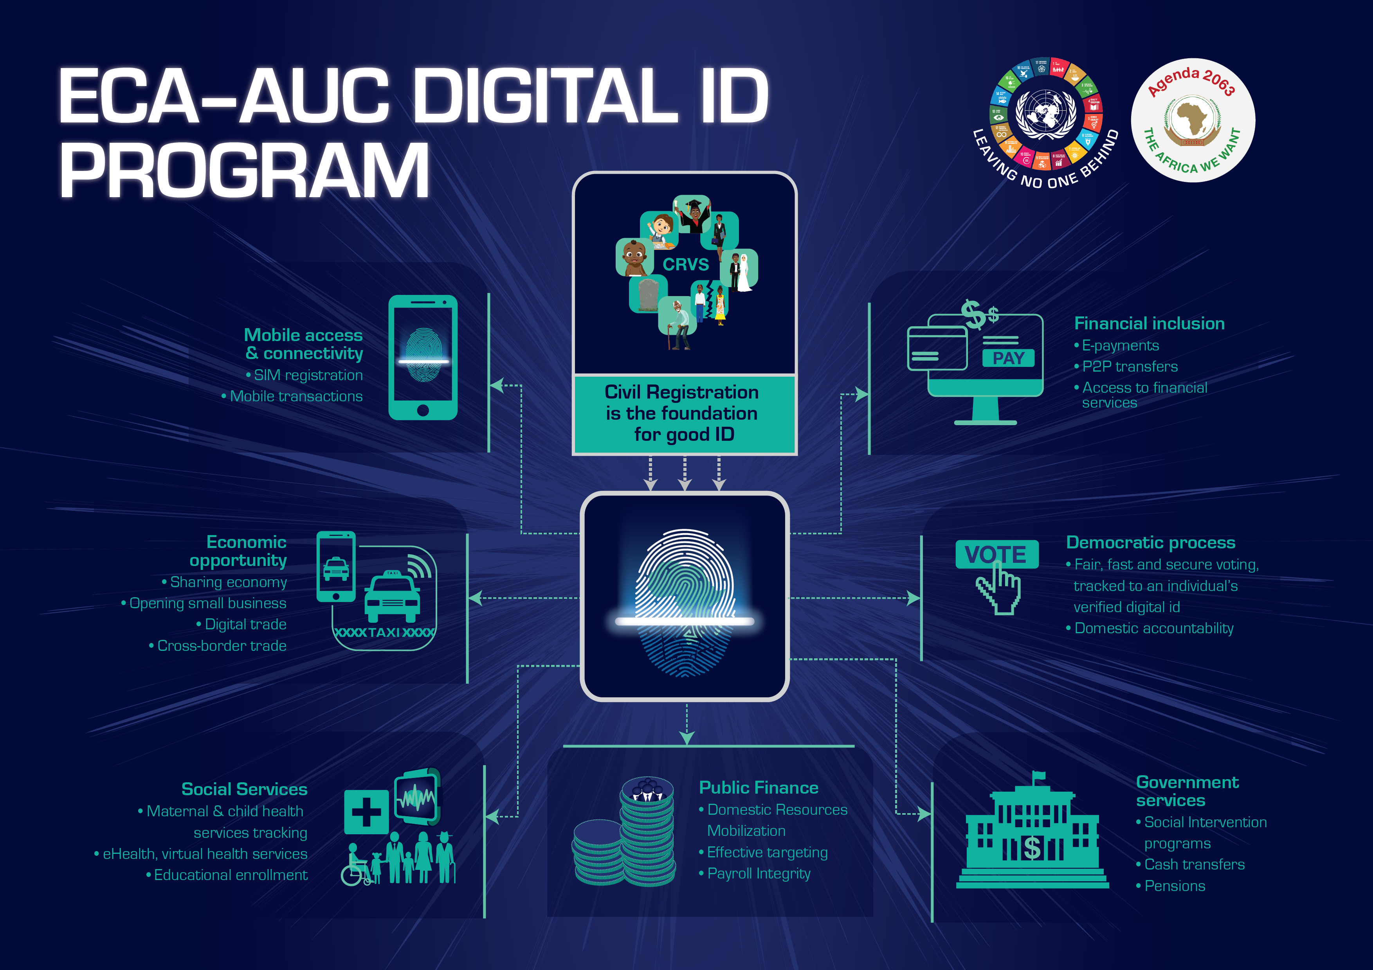
African e-commerce is growing, at an estimated annual rate of 40%. Digital economy in Africa is expected to grow to over $300 billion by 2025 (on the back of massive mobile penetration, among other technologies.
Digital identification can be an important catalyst for various development initiatives in the continent, impacting on trade, governance, social protection, financial inclusion, domestic resource mobilization, as well as security and human rights.
https://www.uneca.org/dite-africa/pages/what-are-benefits-digital-id-digital-trade-and-digital-economy-africa

Slide 35
DIGITAL IDENTITY IN PRACTICE
Digital identities may take the form of publicly sanctioned or issued digital IDs with the same intended effects as official physical ID documents. Equivalent, real-life identity online, and thereby grant access to a range of public and private services in a safe and secure way.
With e-ID’s, citizens are able not only to do their banking online, but also to gain access to crucial public services, including healthcare, pension, unemployment benefits and welfare – as well as in some cases allowing citizens to vote in national elections.

Slide 36
DYNAMIC DIGITAL ID’s
A form of digital identities may be dynamic identities that are based on captured behavioural history on multiple websites and apps. Such identities allow for the verification of personal identity using personal characteristics such as typing style, movement of mouse pointer and perhaps even reading and time spent on websites.
Such a system could verify, with a high degree of certainty, that people are who they say they are.
However, from a privacy perspective, dynamic digital identities bear some risks of profiling and misuse if and when a person prefers not to be directly identified.

Slide 37
REGULATING DIGITAL IDENTITIES
From a privacy perspective, there are several things to be considered. One is the security aspect of a digital identity, which is described above. The other aspect is the actual creation of the digital identity itself, including access to and collection of the data during the registration phase, and the actual storage of biometric data.
In order to ensure privacy and security, regulations on digital identity must address technical and organizational requirements for the issuing of e-IDs. One example is the EU e-IDAs regulation, which harmonises the use of official digital identities across all EU member states, and which sets specific requirements for security and authentication.

Slide 38
DATA SECURITY

Slide 39
WHAT BARRIERS DOES INDUSTRY FACE IN SECURING DATA?
Securing data is easy – but it can be difficult to secure data that you can access and process easily, share safely, and update when required, all while keeping costs down.
5 barriers to preventing the safe storage, processing and transmission of data are:
  Awareness of the data landscape
  Awareness of threat landscape
  Appetite
  Cost
  Ability
  Organizations need to increase awareness of the threats they face as guardians of data.

Slide 40
REGULATORS
Regulators are now taking a leading role in defining standards and reasonable expectations for organizations and companies, and the steps they must take in order to safeguard personal data.
Co-regulation offers a flexible middle way approach to defining and attaining standards, this allows industry and government to combine and incorporate industry established standards for cybersecurity containing measures for data protection.
Organizations and companies can choose to either comply with ISO 27001, or become externally certified, this scalable model makes for easier co-regulation definition and measurement, and delivers a layered approach to data protection security.

Slide 41
INNOVATION IN SECURITY
Traditionally, security vendors have based their products and technology on traditional security practices such as creating a secure perimeter , on the premise that if you build a wall high enough and put all your assets behind it, you should be reasonably safe.
There are a number of newer technologies and concepts now available to security practitioners: Patching; Encryption; Authentication.
The biggest development in security, however, is blockchain, which has been described as a disruptor to the way many industries process database-based transactions.

Slide 42
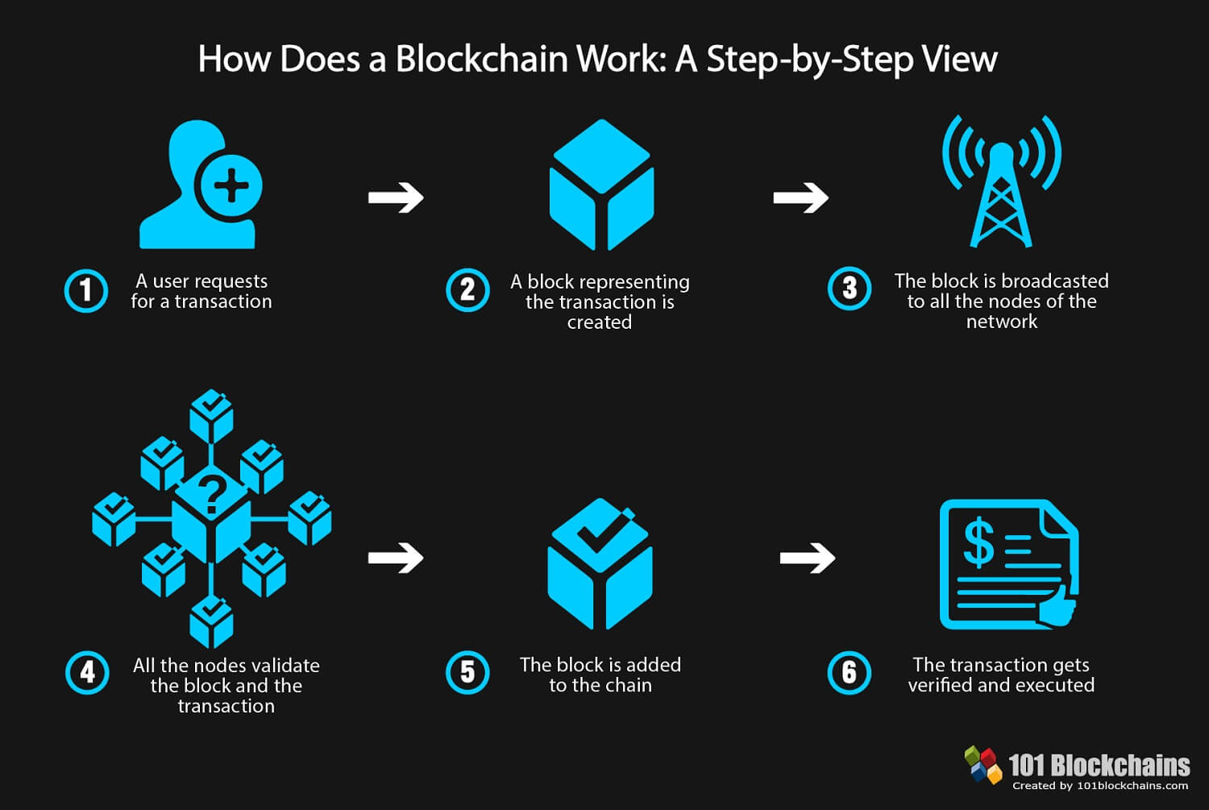

Slide 43
INNOVATION IN SECURITY
Transactions taking place online and the sharing of data could both be done using blockchain technology: distributed data storage and multiple points for an audit trail.
Hackers can currently infiltrate networks with relative ease and go to servers or storage devices and remove or change data. They would struggle to do this against the multiple targets they would need in a distributed blockchain model, however, as they would effectively have to target all members of the blockchain at the same time.
Blockchain would also offer a much higher level of protection to the integrity of data, since any data changed in only one part of the blockchain would be much quicker to spot than in traditional storage solutions.

Slide 44
CONCLUSIONS/ REFLECTIONS

Slide 45
PRIA CHETTY pria.chetty@endcode.org www.endcode.org
THANK YOU

